Slide 1
Bluefin’s PayConex™ Payment Processing for MBNA Members Payment processing with encryption and tokenization to secure your transactions
2021

Slide 2
Bluefin and MBNA Partnership
Founded in 2007, Bluefin is a leader in providing security and payment processing for SMB’s, financial firms, healthcare organizations, retail and higher education
Bluefin protects payment data and reduces card fraud by devaluing cardholder data and preventing it from being compromised
In 2012, MBNA partnered with Bluefin to offer payment processing direct to MBNA members
We are excited to bring our new payment gateway features to MBNA members!

Slide 3
Why Bluefin?
Process credit, debit and ACH transactions face-to-face contactless, mobile, MOTO, or online
Simple setup – no implementation required
Immediate encryption of payment card data in our PCI-approved devices
Tokenization (data masking) card on file solution – ideal for recurring payments
Competitive “meet or beat” payment processing rates
Direct customer service through Bluefin
Leader in payment and data security

Slide 4
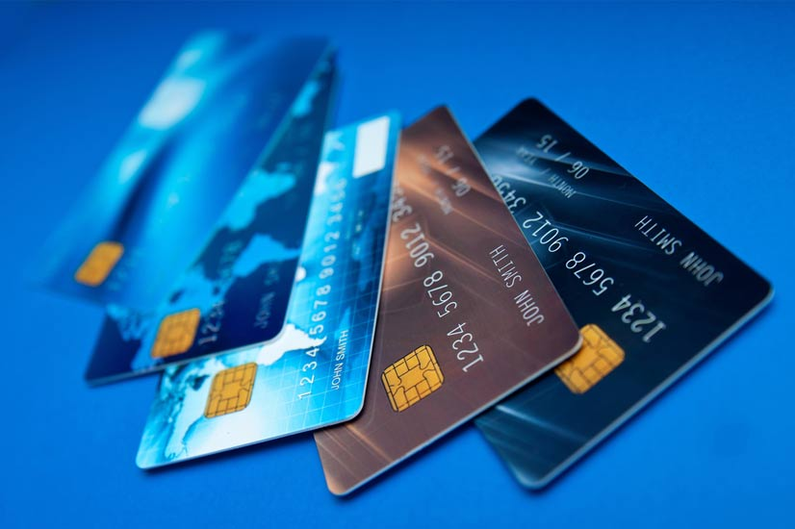
What Are Electronic Payments?
As opposed to a physical payment, such as cash or check, electronic payments are those conducted “online” through a payment network
Examples of Electronic Payment Types
Credit &
Debit Cards
ACH (Electronic Transfer from Bank Account)
Near Field Communications (Mobile Wallet)

Slide 5
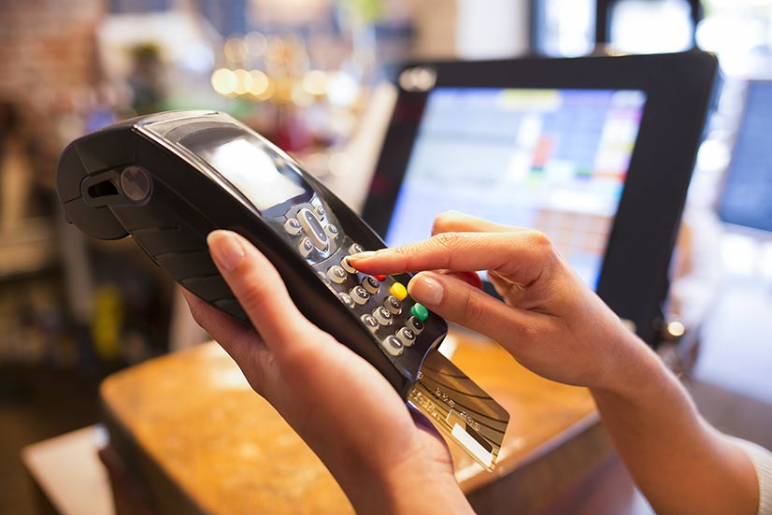
There Are a Variety of Ways to Pay Electronically
Physical Point of Sale
Mail or Telephone Order
Online (Ecommerce)

Slide 6
What PayConex Provides MBNA Members
POS, Mobile, MOTO, and Ecommerce Payments
Credit/Debit/ACH/Apple Pay/Google Pay/Samsung Pay
Recurring Billing/Card on File/Account Updater/QuickBooks Integration
PCI-Validated Point-to-Point Encryption (P2PE), Tokenization, Chargeback Management, 3D Secure (3DS), and ShieldConex® Data Security Platform
4 P2PE Certified Devices for Payment Acceptance
Back-end processing connections include Elavon and First Data

Slide 7
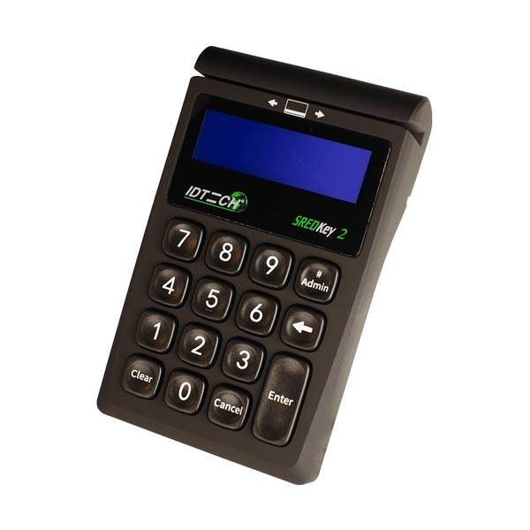
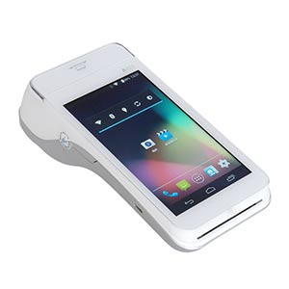
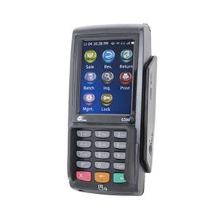
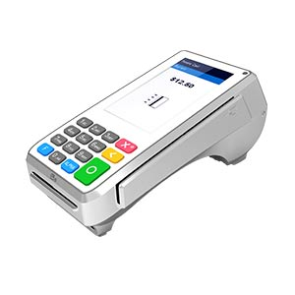
Choose From a Variety of Devices for Your Business
Face-to-Face, Mobile and MOTO P2PE Payment Devices Integrated to PayConex*
ID Tech SREDKey 2
POS, Mobile, Call Center
PAX-A80
POS, NFC, Wifi
PAX A920
POS, Mobile, NFC
PAX S300
POS, NFC
You can also get Ecommerce payment processing with our hosted payment forms
*EMV and Contactless Debit/Credit Acceptance; Apple Pay/Google Pay/Samsung Pay Acceptance. Learn more at https://www.bluefin.com/p2pe-devices/

Slide 8
Get Started Today!
Simply visit our MBNA partner landing page at https://www.bluefinpartner.com/mbna/ and fill out our online form. A members of our sales team will contact you directly to discuss our payment processing options and rates for your business. You can also call 1-800-675-6573 Ext. 1 to speak to a representative at Bluefin.

Slide 9
Additional Resources
https://www.bluefin.com/news/

